Slide 1






EMIGRATION TRENDS
(2024-2035)
Presented by : 2024-MS-DS-11

Slide 2




PROBLEM STATMENT
"Develop a predictive model to forecast emigration trends and analyze the evolution of emigrants' skill composition over time."

Slide 3



SIGNIFICANCE
1
Actionable insights for emigration trends.
2
Professional distributions
3
data-driven decision-making

Slide 4
OBJECTIVE
Visualizing Emigration and Professional Trends for clear insights.
1
2
Analyze changes in emigrants' skill composition over time.
3
Predict emigration trends to global destinations using historical data.
4
Forecasting in-demand professions for future workforce planning

Slide 5

POTENTIAL IMPACT
INTERNATIONAL COLLABORATION:
Fosters partnerships by analyzing skill flows.
ENHANCED PLANNING:
Assists NGOs and organizations in emigration-related programs.
EMITIGATING SKILL GAPS:
Reduces shortages in critical sectors with actionable insights.

Slide 6

QUESTIONS
Trends Analysis
How has emigration changed over time?
What are the top destination countries?
Are there any notable spikes or drops in emigration?
What are the top professions among emigrants?
How has the skill composition of emigrants changed over time?

Slide 7
QUESTIONS
Forecasting
Predictions for total emigrants (2024–2035)?
Predicting number of emigrants to a specific destination country (2024-2035)?
Forecast 5 most in-demand professions for each year (2024–2035)?

Slide 8

DATA SOURCES
1. Country-wise Emigration Dataset (1981–2023):
File: number-of-pakistani-emigrants-country-wise-1981-2023.csv
Source: Kaggle, opendata.com.pk
2. Profession-wise Emigration Dataset(1981–2023):
File: Emigrants-data-profession-wise(1981-2023).csv
Source: Kaggle, opendata.com.pk

Slide 9
Data Wrangling
Prepping the Data for Analysis
Data Cleaning
Feature Engineering
Handling missing values
Standardizing data types
Removing irrelevant columns
Defining Feature and Label
Identifying and addressing outliers in the data

Slide 10


Handling missing values
<country.fillna({'No. of Emigrants': 0}, inplace=True)>
<profession.fillna({'No. of Emigrants': 0}, inplace=True)>
Drop unnecessary columns in country dataset
<columns_to_drop = ['Origin Country Latitude', 'Origin Country Longitude', 'Dest. Country Latitude',
'Dest. Country Longitude']
country.drop(columns=columns_to_drop, inplace=True)>
Defining Feature and label for Predictions
<features = country[['Year', 'Destination Region', 'Destination Country']]>
<label = country['No. of Emigrants']>
Fira Code

Slide 11
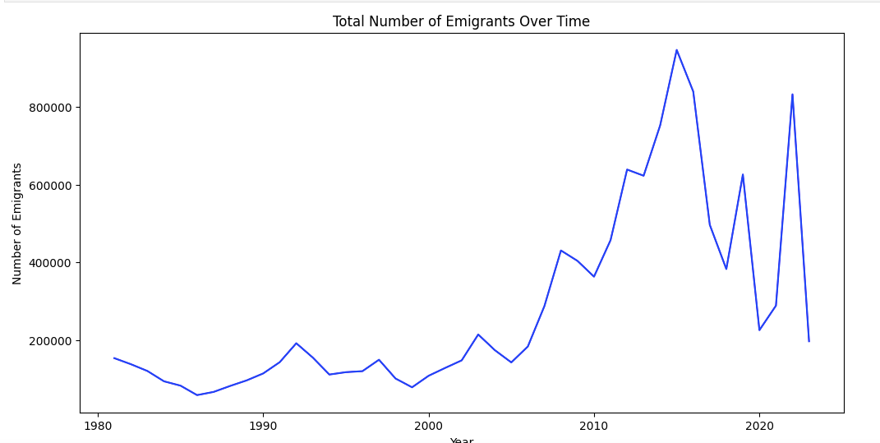
RESULT & FINDINGS
Emigration Trends Analysis
The rise in emigrants notably started around 2008, with the peak year being 2015. This indicates a significant shift in emigration trends during this period

Slide 12
RESULT & FINDINGS
Destination Country | Number of Emigrants
Saudi Arabia | 6056878
United Arab Emirates | 3950935
Oman | 898368
Qatar | 301038
Bahrain | 200785
Top destination countries
Saudi Arabia leads with over 6 million emigrants, followed by the United Arab Emirates,Oman, Qatar, and Bahrain.

Slide 13

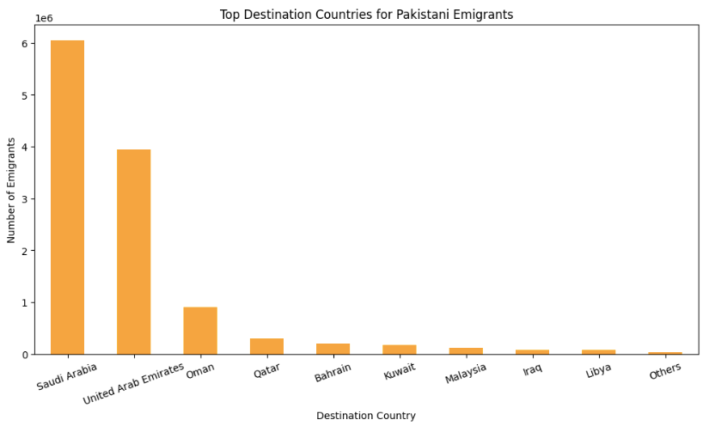

Slide 14

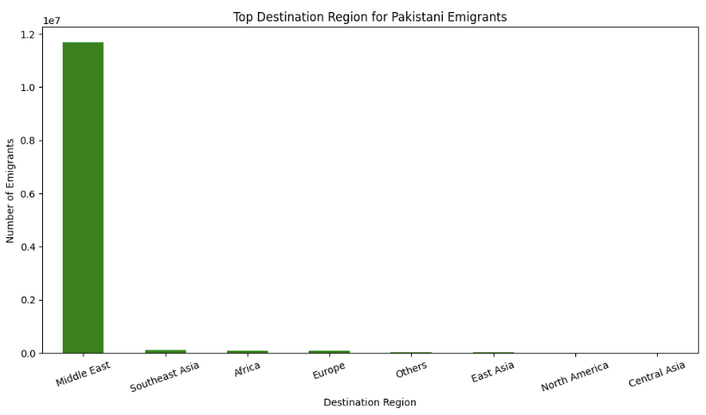

Slide 15

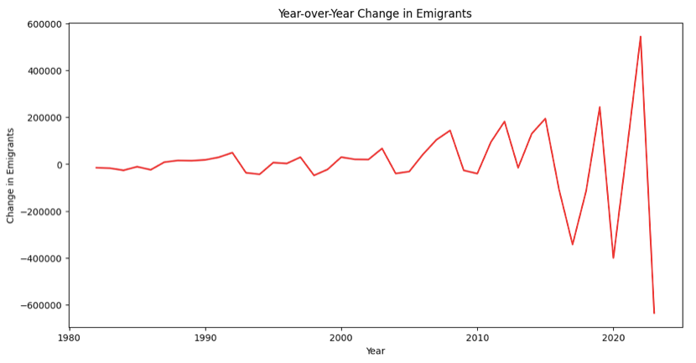

RESULT & FINDINGS
Spikes:
The most significant spike occurred around 2015 and 2022
Drops:
A sharp drop followed in 2018 and 2020-2001

Slide 16
RESULT & FINDINGS
Profession | Number of Emigrants
Labourer | 4677463
Driver | 1701881
Mason | 789023
Carpenter | 514488
Technician | 476058
Top professions contributing to emigration?
The majority of emigrants come from blue-collar professions, with Labourers leading at over 4.6 million, followed by Drivers,Masons, Technicians

Slide 17

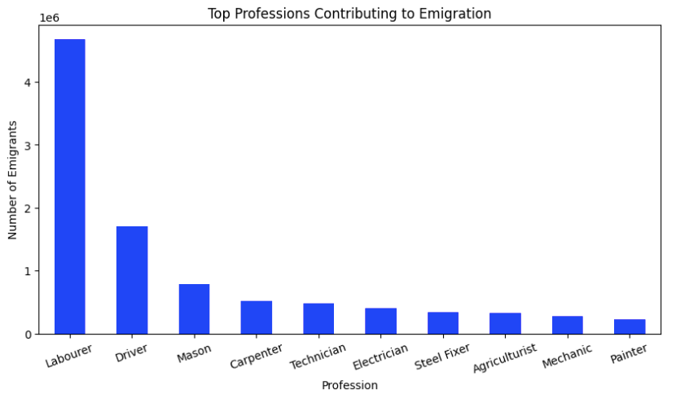


Slide 18
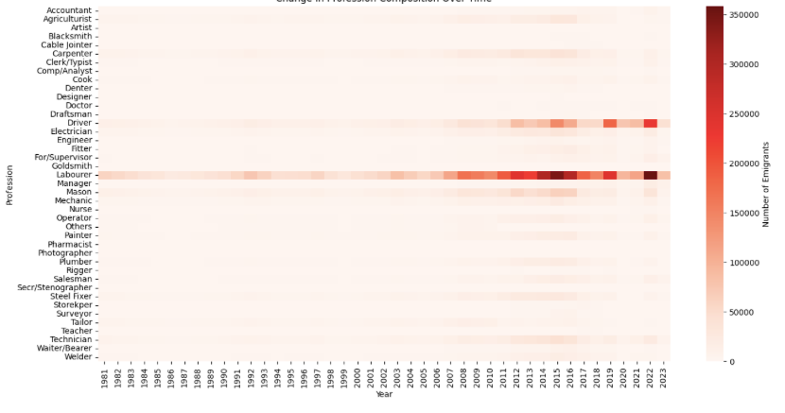
Change in Profession Composition Over Time

Slide 19
FORECASTING & PREDICTIONS
Predictions for total emigrants (2024–2035)?
Year | Predicted Total Emigrants
2024 | 363018.41
2025 | 363018.41
2026 | 363018.41
2027 | 363018.41
2028 | 363018.41
2029 | 363018.41
2030 | 363018.41
Use:
Random Forest:
R² = 0.5149,
RMSE = 182470.113, MAE = 134436.3889

Slide 20
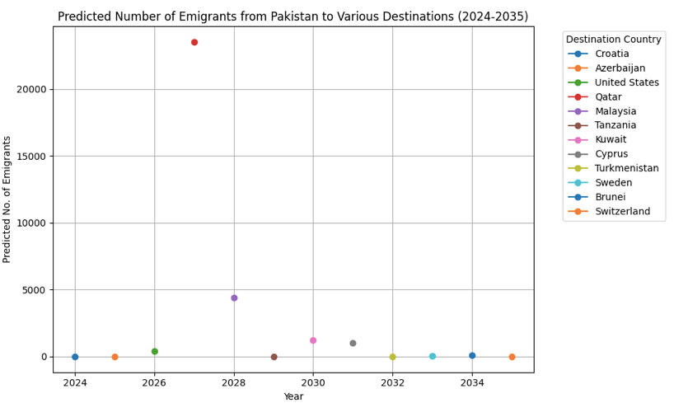
FORECASTING & PREDICTIONS
Predicting number of emigrants to a specific destination country (2024-2035)?
Use:
Random Forest:
R² = 0.9158,
RMSE =31711282.96,
MAE = 947.1256

Slide 21
Predicting number of emigrants to a specific destination country (2024-2035)?
sr | Year | Origin Country | Destination Region | Destination Country | Predicted No. of Emigrants
0 | 2024 | Pakistan | Europe | Croatia | 11.10
1 | 2025 | Pakistan | Europe | Azerbaijan | 13.88
2 | 2026 | Pakistan | North America | United States | 416.72
3 | 2027 | Pakistan | Middle East | Qatar | 23504.30
4 | 2028 | Pakistan | Southeast Asia | Malaysia | 4401.67
5 | 2029 | Pakistan | Africa | Tanzania | 15.73
6 | 2030 | Pakistan | Middle East | Kuwait | 1211.48
7 | 2031 | Pakistan | Europe | Cyprus | 1015.31
8 | 2032 | Pakistan | Central Asia | Turkmenistan | 2.98
9 | 2033 | Pakistan | Europe | Sweden | 42.10
10 | 2034 | Pakistan | Southeast Asia | Brunei | 92.74
11 | 2035 | Pakistan | Europe | Switzerland | 10.82

Slide 22
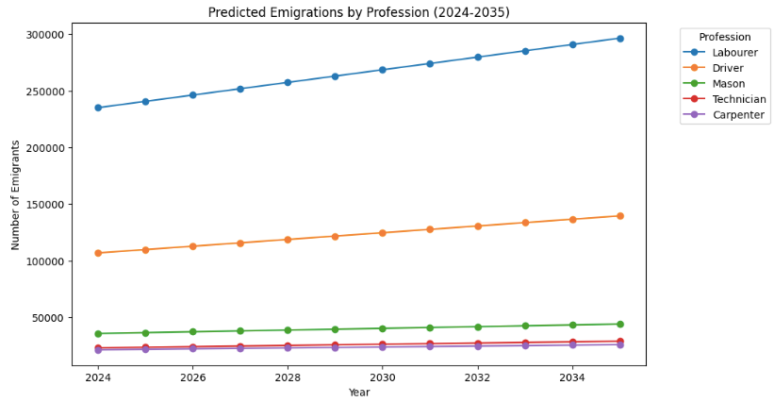
FORECASTING & PREDICTIONS
Forecast 5 most in-demand professions for each year (2024–2035)?
Labourers, drivers, masons, technicians, and carpenters are consistently the top in-demand professions from 2024 to 2035

Slide 23




CONCLUSION
This project analyzed emigration trends and skill composition of Pakistani emigrants from 1981 to 2023, revealing Saudi Arabia and the UAE as top destinations and laborers as the most common profession. Predictive models forecasted trends for 2024–2035, identifying high-demand professions and key migration patterns. These insights provide valuable guidance for workforce planning and policy development, showcasing the practical application of data science techniques to real-world problems.

Slide 24

THANK YOU
Presented by : Laiba Abbas

